Slide 1
2023 SICSS-Rochester
Jiamu Tang (Chan)

Slide 2

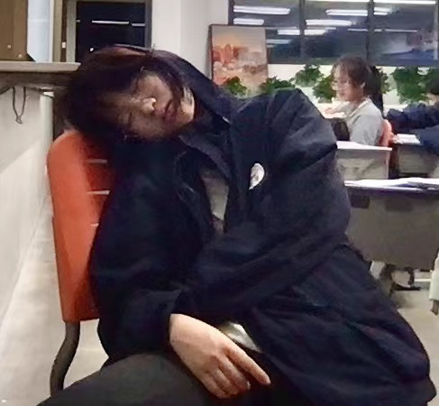
Me.
A human-being name Jiamu Tang /Chan
2026 Undergraduate/University of Rochester/ Data science & Philosophy
Reading/Hiking/Traveling/Badminton/Skateboarding/TRY NEW & TRY MORE!
164~165 cm

Slide 3
Some skills

Slide 4
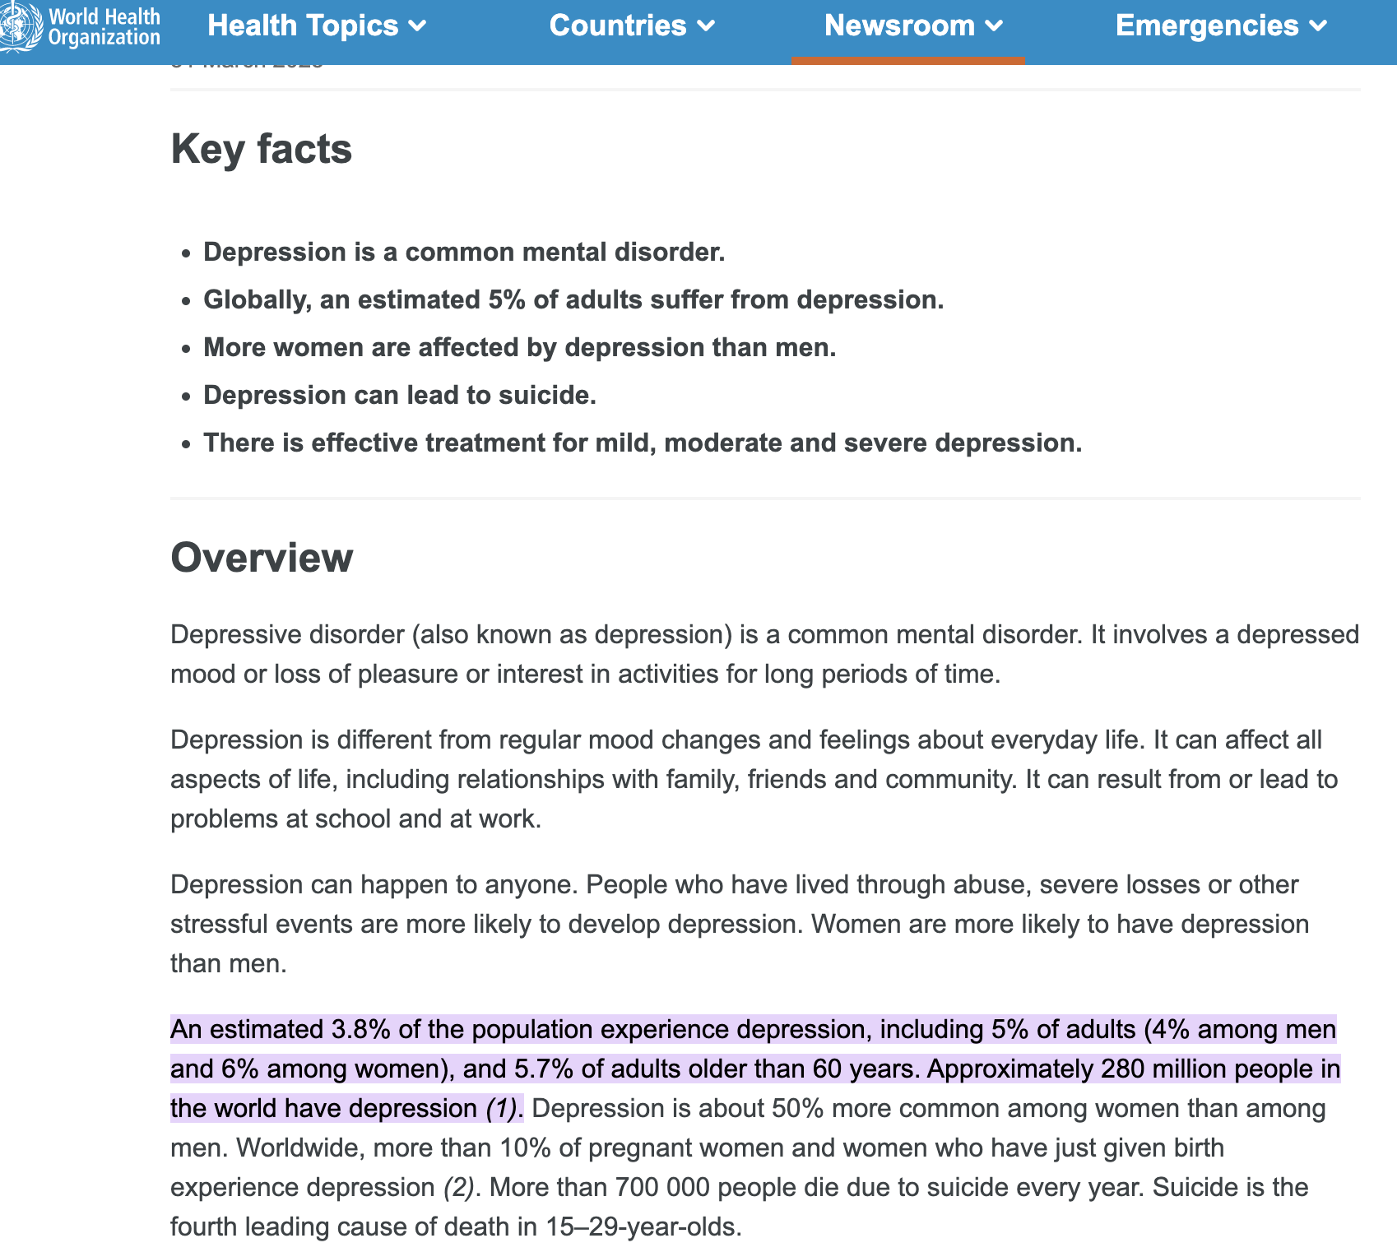
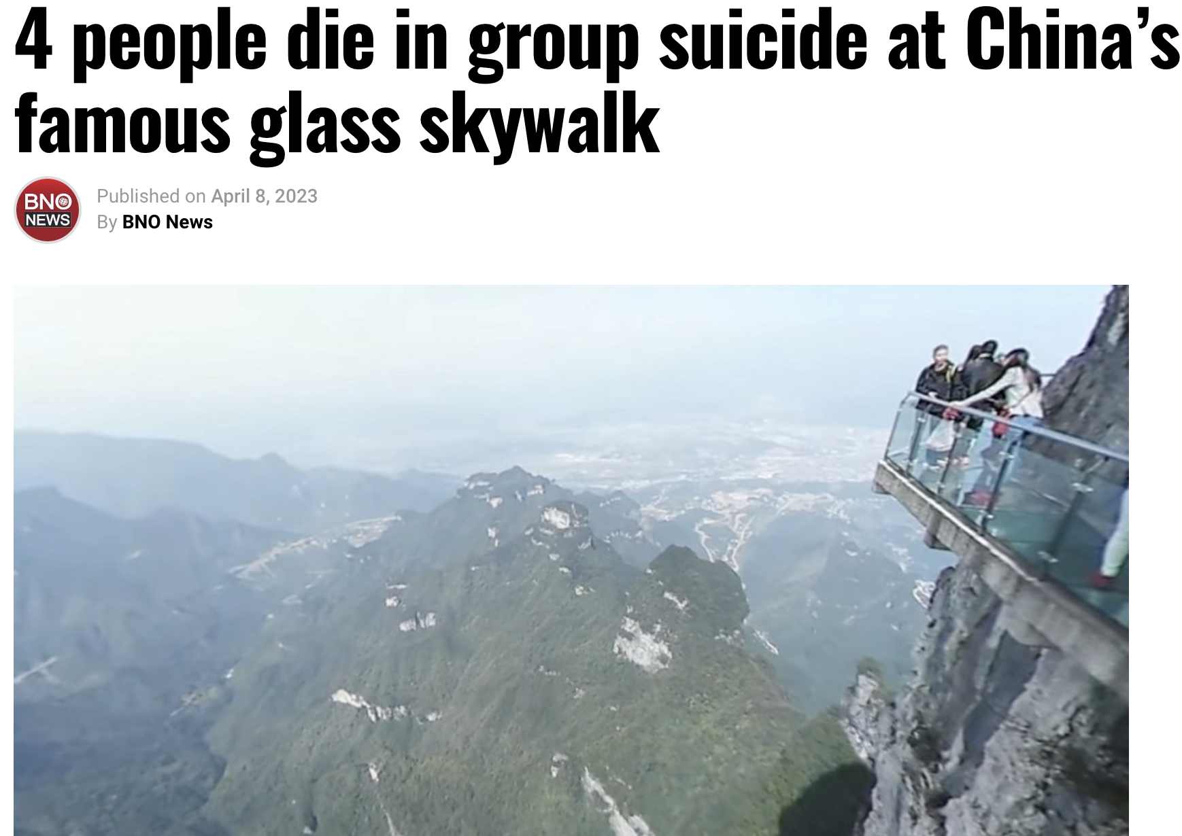
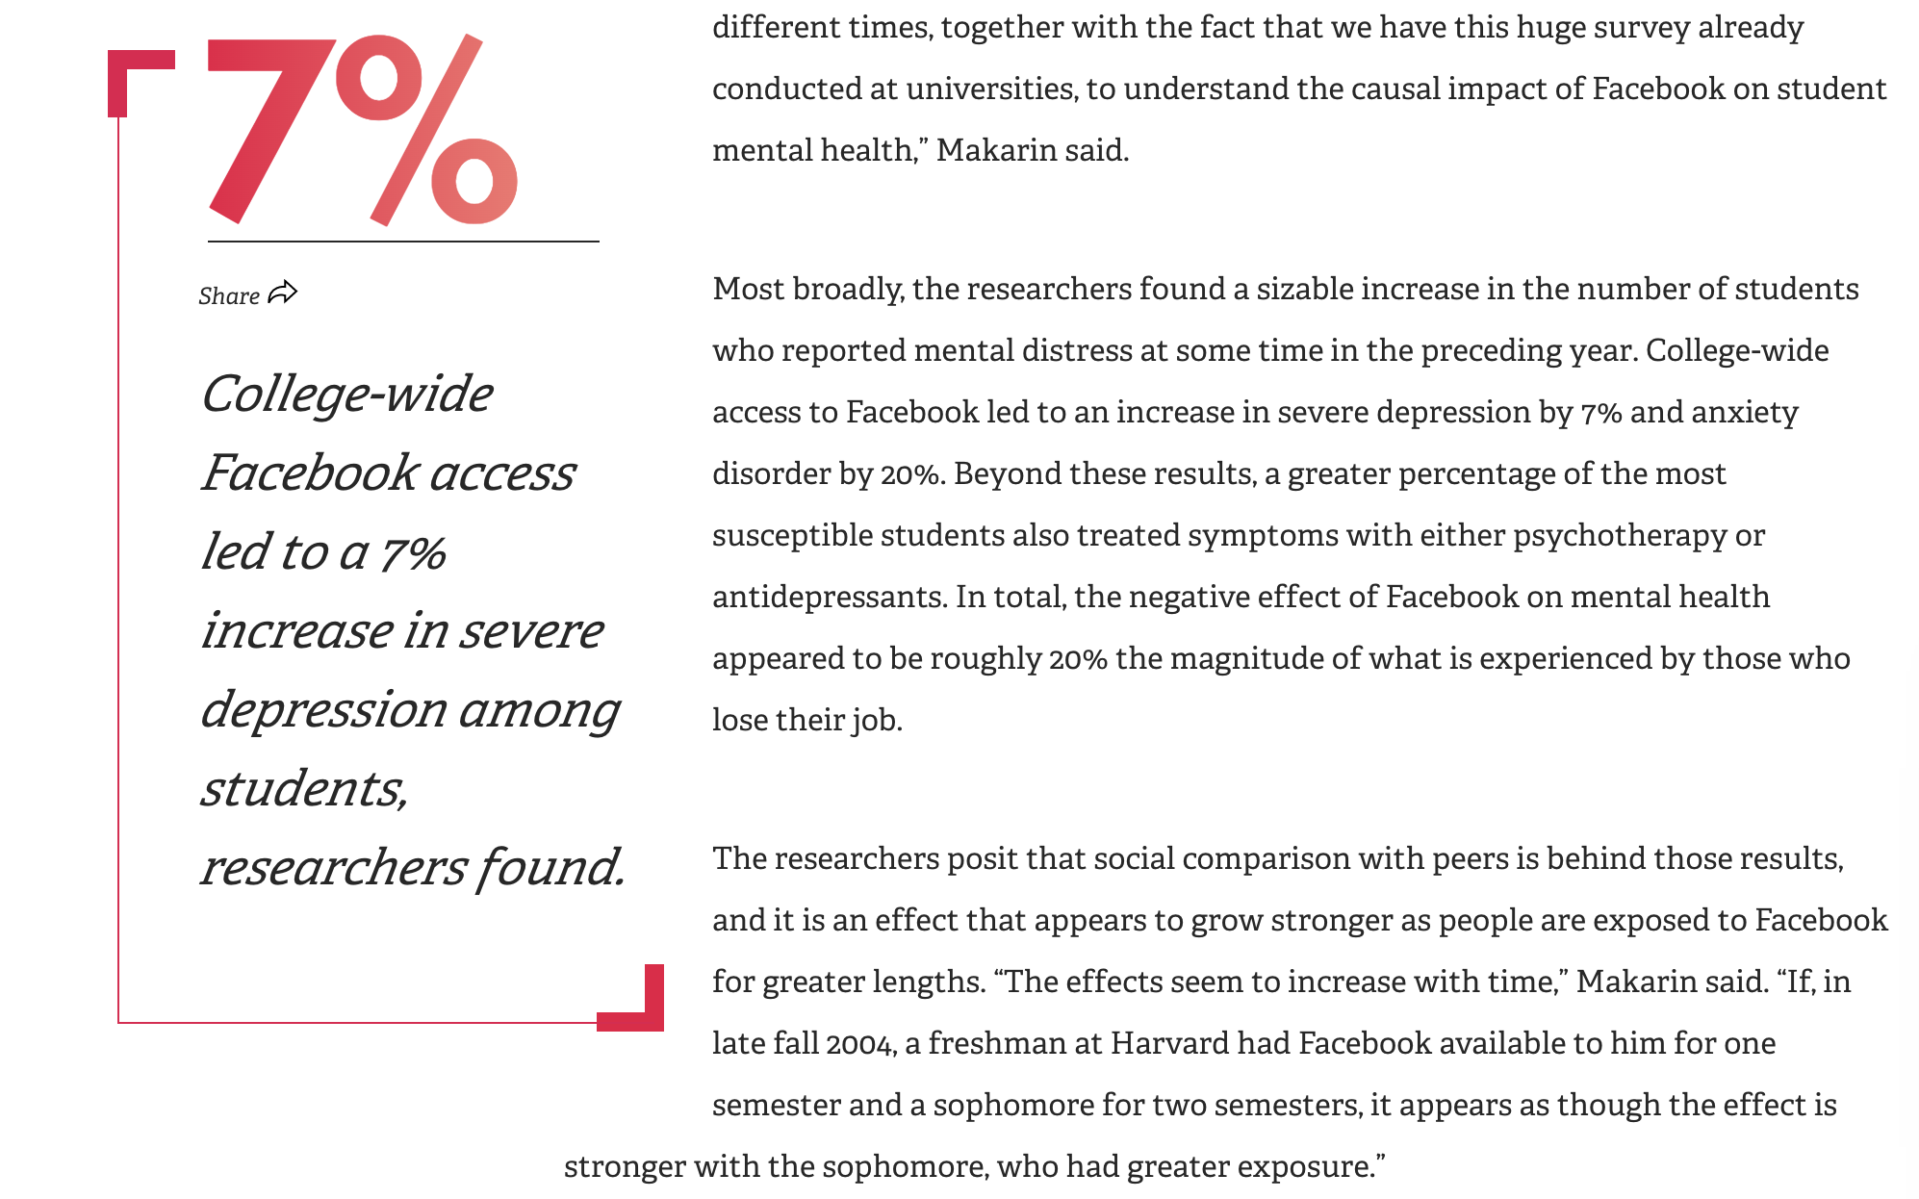
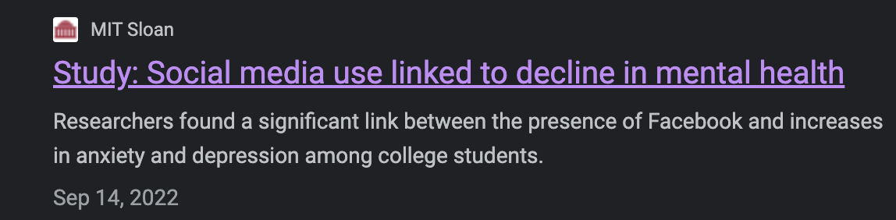
some news
Mar 31, 2023

Slide 5
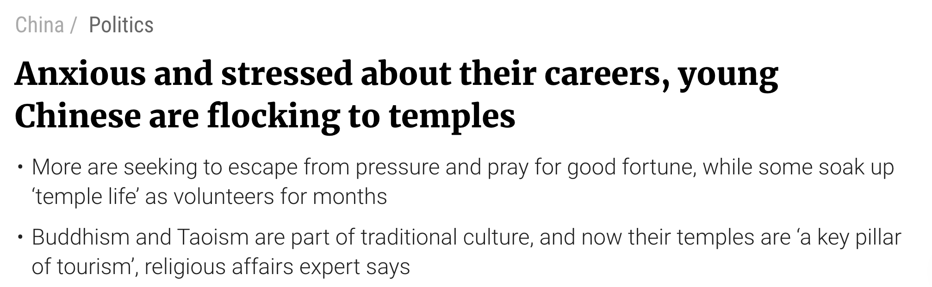
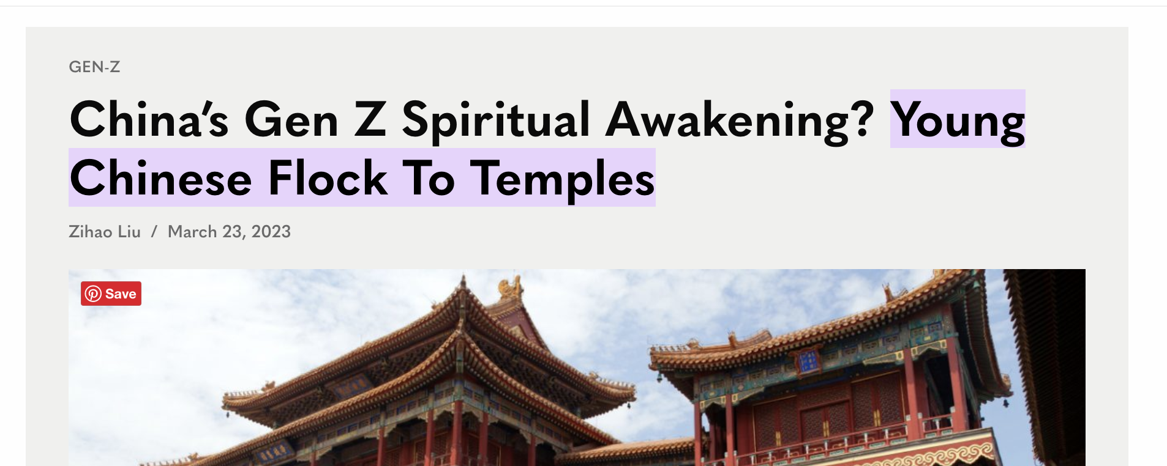
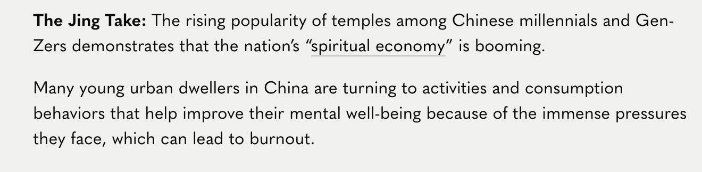
Z generation

Slide 6
IDEA 1.0
"Is there certan linguistic patterns in social media posts relate to suicide risk and depression severity?"
it seems to be a good idea.
Q1: There are so many languages and grammars in the world.
Q2:In 2015, paper alreay exist

Slide 7
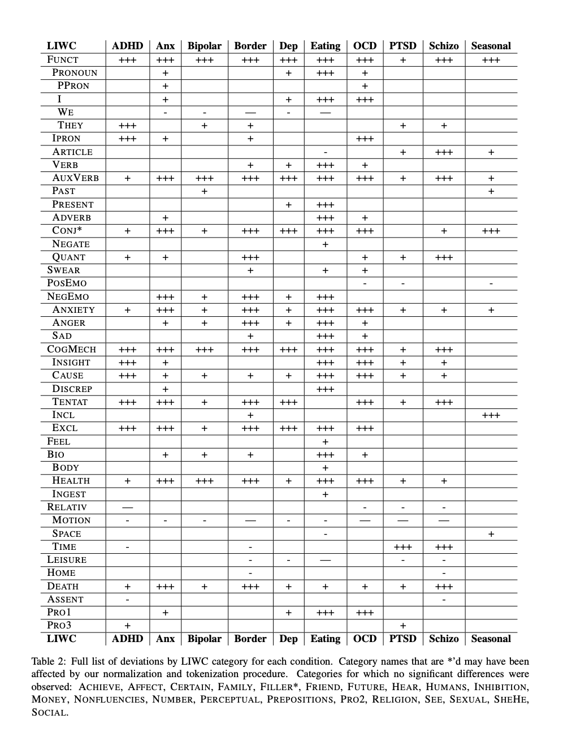
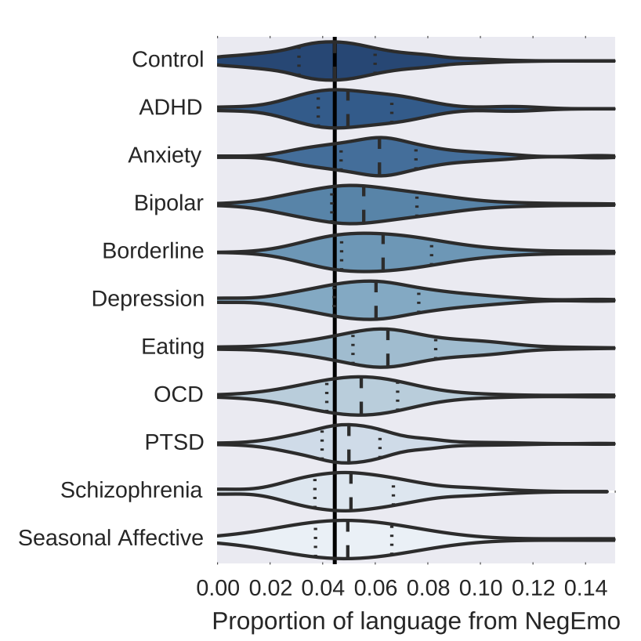
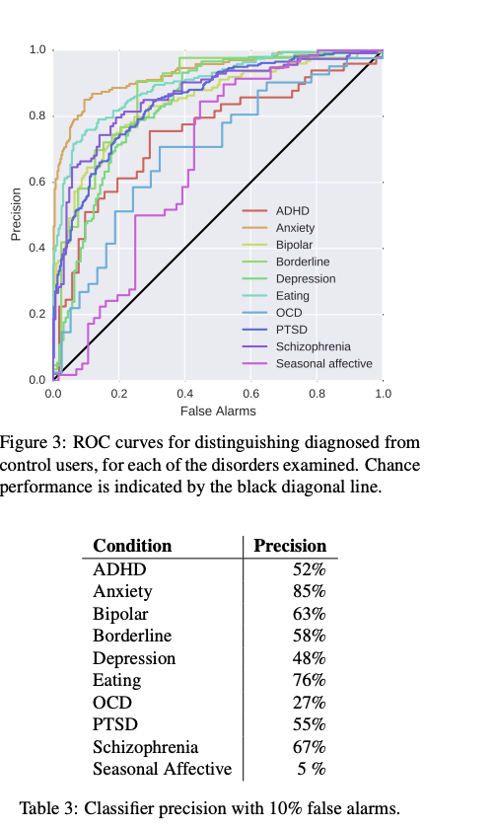
Coppersmith, G., Dredze, M., Harman, C., & Hollingshead, K. (2015). From ADHD to SAD: Analyzing the language of mental health on Twitter through self-reported diagnoses.
O'Dea, B., Larsen, M. E., Batterham, P. J., Calear, A. L., & Christensen, H. (2015). The association between changes in daily mood and later changes in frequency and intensity of non-suicidal self-injury among adolescent girls.
De Choudhury, M., Kiciman, E., Dredze, M., Coppersmith, G., & Kumar, M. (2016). Discovering shifts to suicidal ideation from mental health content in social media.
Yaden, D. B., Kaufman, S. B., Hyde, E., Chirico, A., Gaggioli, A., Zhang, J. W., & Stillwell, D. (2021). Linguistic markers of risk and protection in social media posts of individuals with depression and suicidal ideation.
Coppersmith, G., Ngo, K., Leary, R., & Wood, A. (2018). Exploratory analysis of social media prior to a suicide attempt.

Slide 8
FINe... :(

Slide 9
IDEA 2.0
"How do different linguistic patterns in social media data relate to differences in suicide risk across different cultural and socio-economic contexts?"

Slide 10
Possible objective
To identify existing linguistic markers/even the using of sign like”。 ，“/grammar of suicide risk in social media data across different cultural and socio-economic contexts.
To explore cultural and socio-economic differences in the relevance of existing linguistic markers for suicide risk.
To identify new linguistic markers of suicide risk in social media data that are specific to certain cultures or socio-economic groups.
To develop and test machine learning models that predict suicide risk using linguistic patterns in social media data across different cultural and socio-economic contexts.
Methodology:
The study could involve collecting social media data from different cultural and socio-economic contexts. We will use natural language processing techniques to identify linguistic patterns that may be associated with suicide risk. We will also use machine learning techniques to develop models that predict suicide risk based on linguistic patterns in social media data. We will compare the effectiveness of different linguistic markers across different cultural and socio-economic contexts and identify new linguistic markers that are specific to certain cultures or socio-economic groups.

Slide 11
Possible resources
Twitter API
Reddit API
Facebook API
Tiktok API
Ins API
Crisis Text Line: Crisis Text Line is a non-profit organization that provides support and crisis intervention through text messaging. They provide an anonymized dataset of text messages exchanged between crisis counselors and individuals seeking help, which could be used to analyze linguistic patterns related to suicide risk.
National Center for Health Statistics: The National Center for Health Statistics provides data on suicide rates across different demographic and socio-economic groups in the United States, which could be used in conjunction with social media data to analyze linguistic patterns related to suicide risk in different contexts.

Slide 12
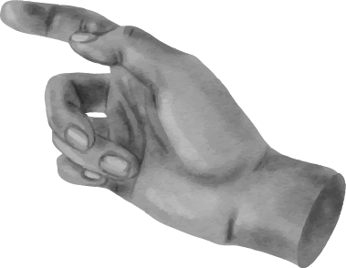
Thx for your listening!
谢谢你的聆听
들어 주셔서 감사합니다
Danke fürs Zuhören
dinlediğiniz için teşekkürler
শোনার জন্য ধন্যবাদ

